Slide 1
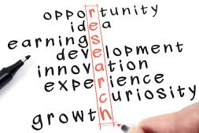
Research is a search for truth?

Slide 2
Research is the professional quest for truth, based on appropriate knowledge

Slide 3
Research Methodology
Research methodology is an over-arching term relating to the development of knowledge and the nature of that knowledge
Refers to the progress of scientific practice based on philosophies and assumptions about the world and the nature of truth and knowledge
Research Paradigm
A paradigm is a basic set of beliefs that guide action
Paradigms offer a framework comprising an accepted set of theories, methods, and ways of defining data

Slide 4
Philosophy of Research
Ontology: ways of constructing reality, “how things really are” and “how things really work”..
Epistemology: different forms of knowledge of that reality, what nature of relationship exists between the inquirer and the inquired? How do we know, that we know?
Methodology: What tools do we use to know that reality?

Slide 5
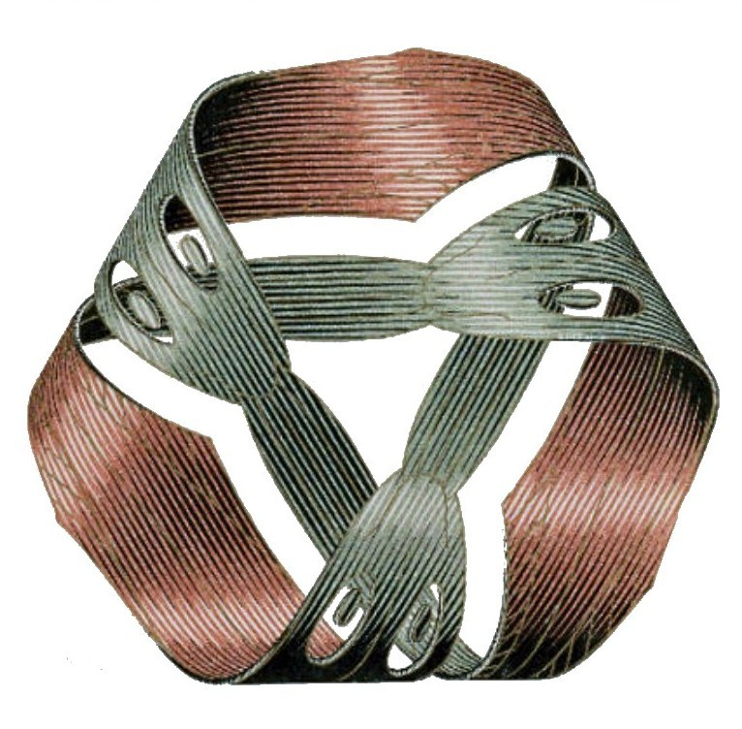
Epistemology
Research Paradigm
Ontology
Methodology

Slide 6

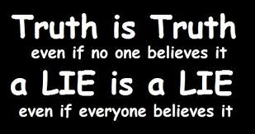
Is there any thing like absolute truth ?

Slide 7
What is the truth
Truth is defined as, ‘quality or state of being true’ or ‘a fact or belief that is accepted as true.’
Oxford dictionary
“There is no truth. There is only perception.”
Gustave Flaubert
“Everything we hear is an opinion, not a fact. Everything we see is a perspective, not the truth.”
Marcus Aurelius

Slide 8
Absolutism VS Relativism
Absolutism: truth is independent of our knowledge and beliefs.
Relativism: there is no absolute truth. What is true for me may be false for you. Truth is a construction, and every person may construct truth differently. Every person’s version of truth is equally legitimate.

Slide 9
The paradox of relativism.
Truth is relative to the speaker/believer.
No statement is necessarily true or false to all believers.
“Truth is relative” is a statement.
“Truth is relative” is not true for everybody.
“There are absolute truths” is not false for everybody.
“Truth is relative” is a self-defeating statement.
If it is true, it is not true for everybody. If its true, its opposite is also true (for some people).

Slide 10
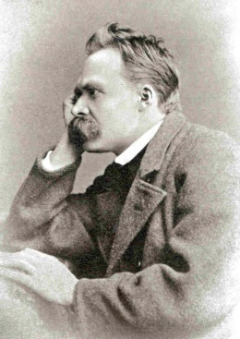
Nietzsche
Truth is useful, if it promotes and enhances life, but a life-enhancing falsehood is better than a truth that undermines life.
“ The falseness of a judgment is to us not necessarily an objection to a judgment... The question is to what extent it is life-advancing, life-preserving, species-preserving, perhaps even species-breeding...“
Friedrich Nietzsche, Beyond Good and Evil

Slide 11
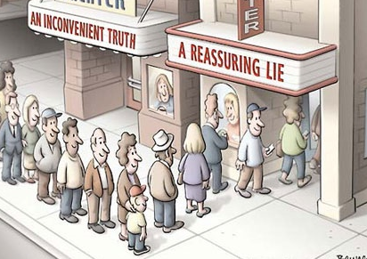

Slide 12
The correspondence theory of truth
Aristotle, Russel, J L Austin
The correspondence theory of truth claims that the truth of a statement depends on its relation to the world of facts. A statement is true if and only if it corresponds to the facts.
Objection:
If we know only our sensory experiences, how can we ever get outside them to verify what reality actually is? What does correspondence mean? Precisely what is a fact?
p is true if and only if p corresponds to the facts

Slide 13
The coherence theory of truth
Leibniz, G.W.F. Hegel, Russell
The coherence theory of truth claims that the truth of a statement depends on its relation to other statements.
A statement is true if and only if it coheres or fits in with that system of statements that we already accept.
Objection: Coherence is no guarantee of truth. If the first statements are false, they can produce a coherent system of consistent error. There is much disagreement even among idealists over first judgments.
p is true if and only if p is logically implied by q, where q is a true statement, and q in turn is logically implied by r, and so on

Slide 14
Pragmatic theory of truth
C. S. Peirce, W. James, and John Dewey. Russel
The pragmatic theory claims that truth depends on what works. A statement is true if and only if it effectively solves a practical problem and thereby experientially satisfies us.
The pragmatist sees the human as needing to use the practical consequences of beliefs to determine their truth and validity.
Objection: There's no necessary connection between truth and workability. Truth is rendered a psychological, not an epistemological, concern, and it can become relative.
Proposition p is true if and only if the belief that “p is true” works

Slide 15
There are three views of truth in science
The instrumentalist view is similar to the pragmatic theory
The realist view is similar to the correspondence theory, and
The conceptual relativist view is similar to the coherence theory

Slide 16
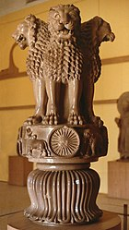

Hindu way of explaining the truth
Four Asiatic lions stand back to back on a circular abacus. The Buddhist wheel of the moral law appears in relief below each lion. Between the chakras appear four animals in profile—horse, bull, elephant, and lion. The architectural bell below the abacus, is a stylized upside-down lotus
Material | Sandstone
Height | 2.1 metres (7 ft)
Width | 86 centimetres (34 in) (diameter of abacus)
Created | 3rd century BCE
Discovered | F. O. Oertel (excavator), 1904–1905
Present location | Sarnath Museum, India

Slide 17
Mundaka Upanishad 3rd part, sloka 1.6
“Truth alone wins (the Self), but not untruth. By truth is laid out the path of the immortal gods, by which the sages, who are without any desires, ascend to where that supreme treasure of Truth is.”
Initial name of Mahabharata was Jaya (win, not happiness)

Slide 18
In Hinduism :
Satyam, has three syllables, “sa,” “ti” and “yam.” Sa and yam are true. The middle syllable, "ti," is untrue. The untrue is enclosed on both sides by Truth.
It is by the path of truth and purity that one ascends to the highest world of Brahman, which is essentially the world of truth (Satyalok). The attainment of Brahman is Moksha
The Upanishads contain the secret knowledge of Truth because they reveal the knowledge of Brahman (Supreme
Self) and Atman (Individual Self),
In the Upanishads, it has been variously described as Sat-cit-ānanda (truth-consciousness-bliss) and as the unchanging, permanent, highest reality

Slide 19
In Buddhism :
conventional truth (saṁvṛti-satya)
and ultimate truth (paramārtha-satya)
saṁvṛti-satya(empirical or pragmatic) : This Truth comprise the essence of Buddha's teachings, though they leave much left unexplained. They are the truth of suffering, the truth of the cause of suffering, the truth of the end of suffering, and the truth of the path that leads to the end of suffering.
Paramartha satya : all things including ultimate truth are ultimately unreal, empty (śūnya) of any intrinsic nature (svabhāva) including the emptiness (śūnyatā) itself, therefore all are groundless.

Slide 20
Let us go a bit further……..

Slide 21
Ontology is ‘the science or study of being.’
Ontology is our view about what is 'real'
What exists? What is 'real'? What is not 'real‘?
An Ontology is a representation of some pre-existing domain of reality which
Reflects the properties of the object within its domain in such a way that there are a systematic correlation between reality and the representation itself.
(2) It is intelligible to domain expert
(3) It is formalised in a way that allows it to support automatic information processing

Slide 22
Reality
Philosophical realism: objects exist and are the cause of our perceptions (one of the causes: an object plus our minds cause perception of an object)
Descartes: how can we know if the world really exists? Maybe it exists and maybe it doesn’t. Maybe the world is real but maybe we are deceived.
Berkeley: there is no mind-independent world.
Objects only exist when they are perceived.
Question: does a virtual world exist ? Is it real?

Slide 23



Optical Illusion

Slide 24
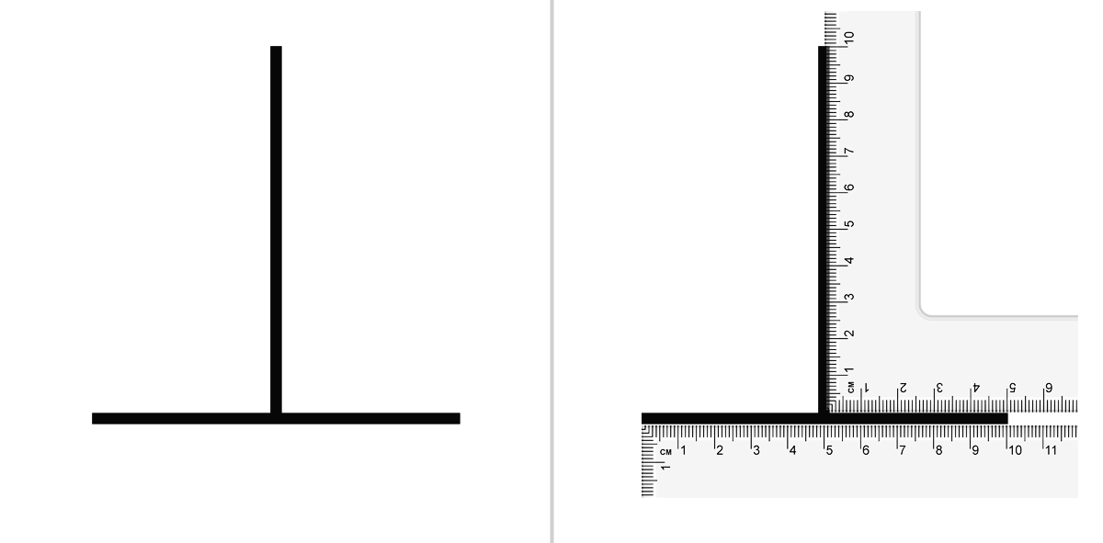

Slide 25

Virtual reality

Slide 26


Slide 27
How do I know which is real or what is the truth
Through knowledge or by knowing, I suppose !
Then, what is knowledge ?

Slide 28
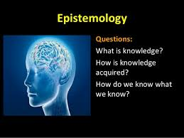
Questions:
What is knowledge ?
How knowledge is acquired ?
How do we know that we know ?
Truth ?
Reality ?
Epistemology: Knowledge about knowledge

Slide 29
What is knowledge ?
“What is known” ....... Wikipedia
Knowledge doe not exist in social vacuum, thus knowledge is justified true belief ............ Plato
But
A true belief can be inferred from a justified false belief
..... Gettier
Knowledge is a theoretical representation of abstract image of an objective situation within human consciousness.

Slide 30
Plato: Knowledge is Justified True Belief
We have knowledge only when a proposition is believed to be true
We have knowledge only when the believed proposition is in fact true
We have knowledge only when we have justification (or warrant) for our belief
P must be true.
I believe P
I have sound reasons for believing P. I need a type of justification
I have no evidence that negates or erodes my belief in P

Slide 31
Epistemology:
is derived from two Greek words: episteme meaning science and Logos meaning discourse.
Therefore meaning of epistemology is simply a discourse on science.
The current dictionary meaning of the term epistemology, is defined as " the study of the basis, nature, limitations and conditions of validity of scientific knowledge, which extends to exact sciences (logic and mathematics), and empirical ones (physics, chemistry, biology, psychology, sociology, etc.)”

Slide 32
Epistemological definition of knowledge
Four distinct types of knowledge: (a) logical, (b) semantic, (c) systemic, or (d) empirical.
Logical knowledge results from the understanding of how ideas are related to one another. Knowing manifests itself in applying accepted rules of logic, which stipulates additional truths.
Semantic knowledge results from learning the meaning of words, which is simply the familiarity with definitions. Systemic knowledge is the learning of a particular system, its symbols, and its interpretations.
Empirical knowledge is the learning to results from our senses. Much of the scientific knowledge falls under this umbrella. In the fact, scientific knowledge relies heavily on empirically derived understanding.

Slide 33
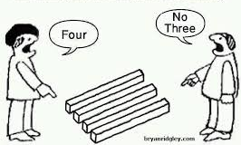

Slide 34
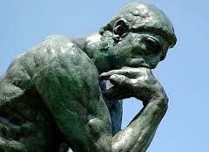
Epistemology in General
Main theme
The Nature and Scope of knowledge
What is knowledge?
How is knowledge acquired?
How do we know that we know?
What is true knowledge How can we have a true knowledge?
What is the criteria of true knowledge?
How do we know that our knowledge is true or false ?
Some of main questions

Slide 35
Extreme of epistemological paradox.
“There are known knowns. These are things we know that we know.
There are known unknowns. That is to say, there are things that we now know we don’t know.
But there are also unknown unknowns. These are things we do not know we don’t know.”
It’s epistemologically brilliant..
The Times, “Great Political TV Moments”, April 17th 2010

Slide 36
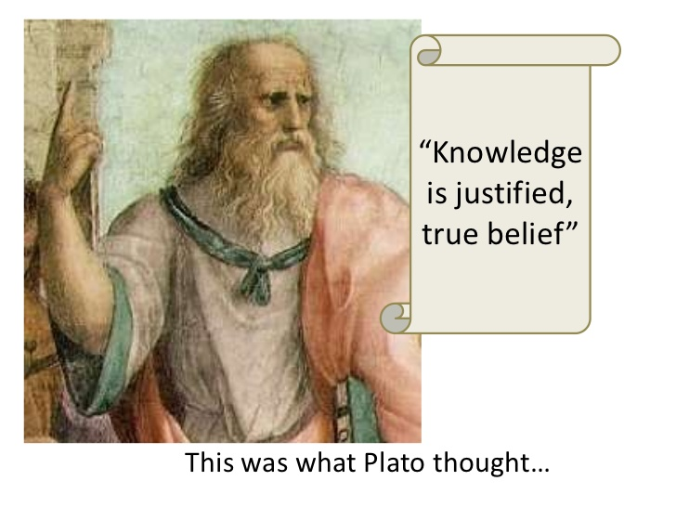

Slide 37
Contemporary Approach
Popper, Kuhn,...
The Epistemological Steps of Contemporary approach
Start from defining knowledge
The question is What is knowledge ?
A knowledge must have 3 epistemic attributes:
Belief
Justified
True

Slide 38
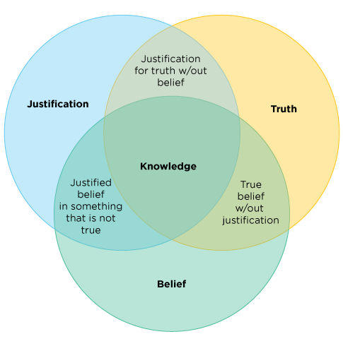

Slide 39
Enquiry on Human Understanding David Hume
Analyzes the empiricist theory that everything we can know about the world is ultimately derived from our senses.
Questions the existence of firm foundations of knowledge other than customary and habitual associations of ideas
Hume says that all reasoning concerning matters of fact is founded on cause and effect
Cause and effect relies on the principle that “the future will resemble the past”, which can not be proven deductively or inductively

Slide 40
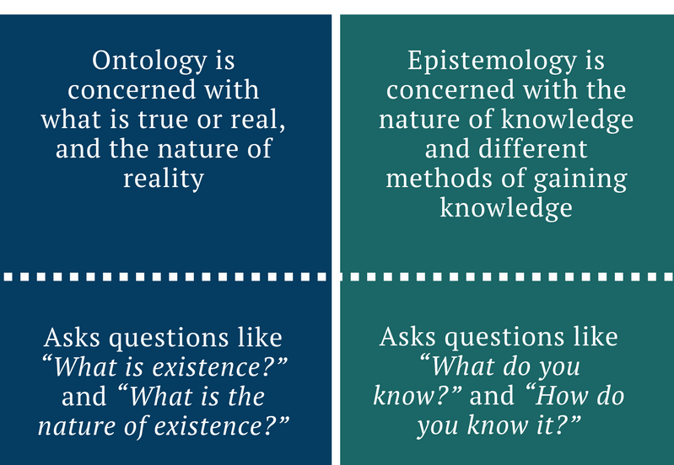
Difference between Ontology and epistemology

Slide 41
Conceptual framework of research
Theory, Hypothesis
Application
What is valuable
A research conceptual framework aligns the researcher’s belief, world view and research methodology
Knowledge
What exists
How do I know ?
Ontology
Epistemology
Essential, Objective, Subjective
Idealist
Empiricist
Realist

Slide 42
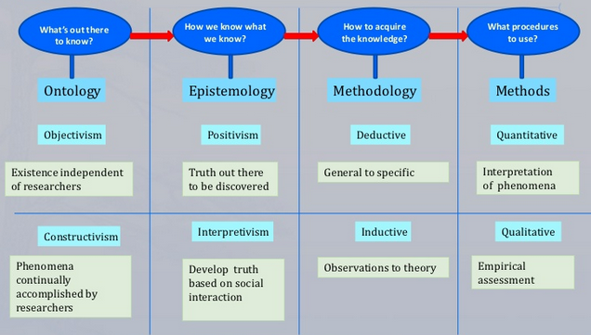

Slide 43
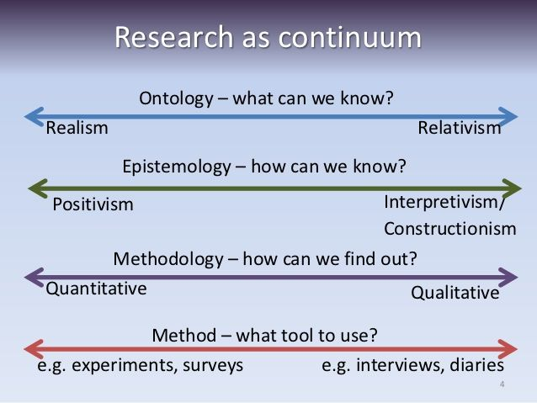

Slide 44
Research methods: The Positivistic approach
Define your research topic
Literature review
Define your research question(s)
i.e. hypothesis
Deductive
Design data collection
Pilot study
Design data analysis
Collect data
Analyse data
Interpret results
Report your findings

Slide 45
Research methods: Phenomenological approach
Define your research topic
Literature review
Define your research question(s)
Inductive
Design data collection
Collect data
Analyse data
Literature review
Interpret data
Research question answered?
Report your findings

Slide 46
Research Onion
Positivism
Realism
Interpretivism
....
Epistemology

Slide 47
Research Onion
Inductive
Deductive
....
Methodology

Slide 48
Research Onion
Theoretical
Experimental
Case study
Survey
Action Research
Methods

Slide 49
Research Onion
Real time
Virtual time
.....
Timing

Slide 50
Research Onion
Data Collection , Sampling , Statistical analysis
Programming

Slide 51
Ph.D
h score
API
D.Sc
Bhatnagar
Nobel

